Slide 1

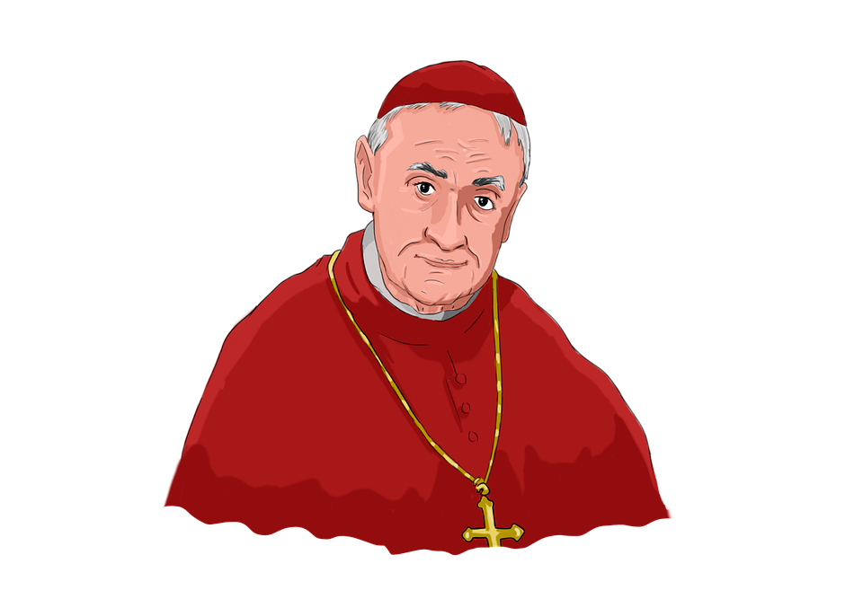
Cardi als
in Mathematics

Slide 2
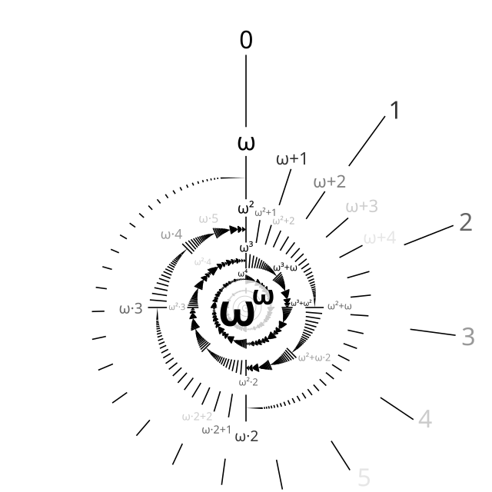
Contents
Finite Sets
Infinite Sets
Important Mathematicians
Cardinal Numbers
Conclusion

Slide 3
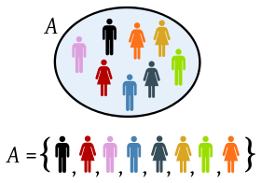


Finite Sets
How do we count the elements of a set?

Slide 4



Infinite Sets
Some examples:

Slide 5
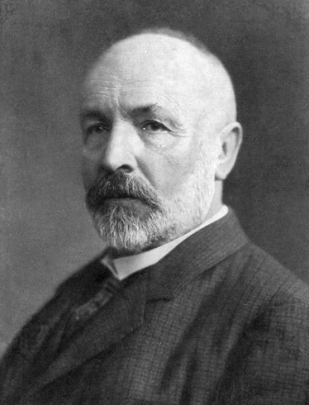
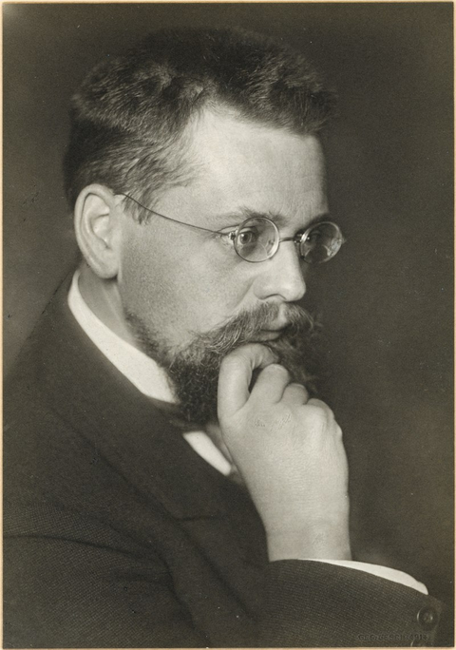
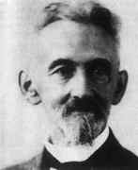
George Cantor
The idea of different sizes of infinities
Ernst Zermelo
The well-ordering principle
Felix Hausdorff
He formalized operations involving cardinal numbers.

Slide 6
Cardi al Numbers
Aleph Notation
. . .
0
1
2
ω

Slide 7
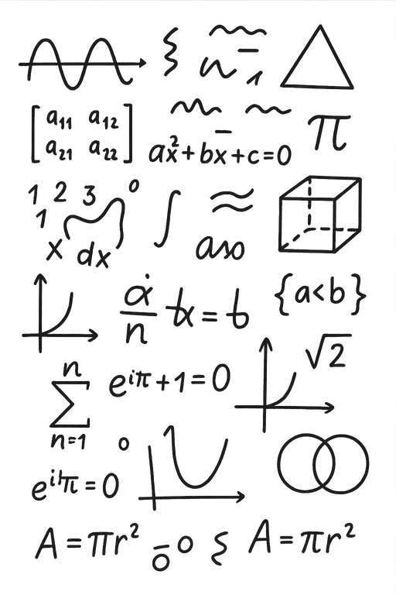

Conclusion
Why is this important?

Slide 8

Thank you for your attention

